Slide 1

Salary Prediction
ISCG 7426 - Data Mining
Adult Dataset
Friday – 18th November 2016
Kritesh
Song
Vahid

Slide 2
Problems to be Solved
What
Salary Prediction according to different criteria like age, education, occupation, race, gender and native country
Why
Salary evaluation and negotiation
Career planning
Social investigation such as: who is earning most

Slide 3
What’s Most Important
For salary prediction:
the accuracy of the prediction
For social investigation:
the salary distribution of different criterion
Which attributes are contributing more to a higher salary

Slide 4
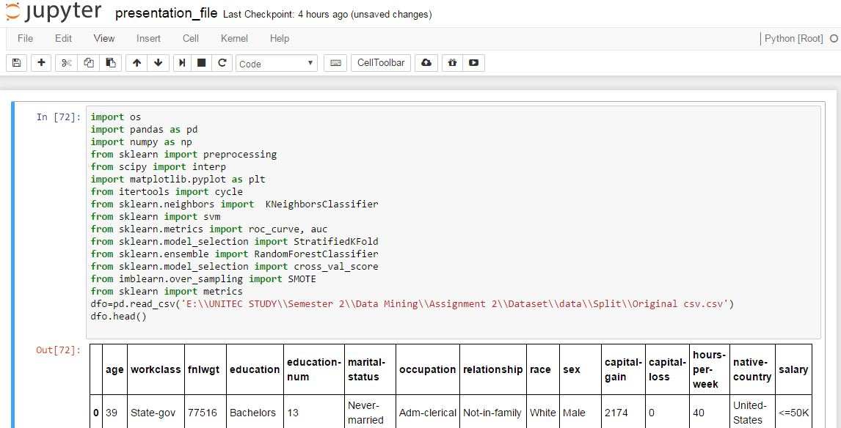
Data Exploration
Useless attributes
Fnlwgt: The # of people the census takers believe that observation represents
Education: there is an equivalent attribute“education-num”in the dataset
Capital-loss
Capital-gain
Duplication
Missing values

Slide 5
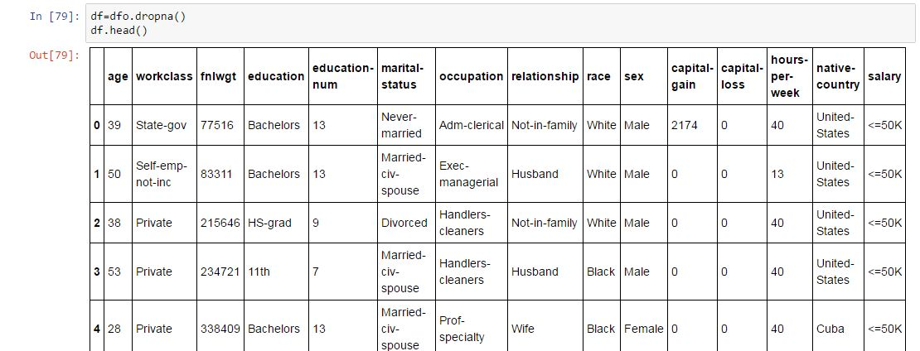
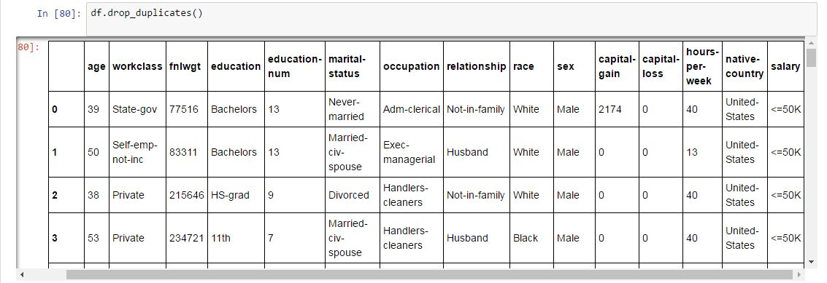
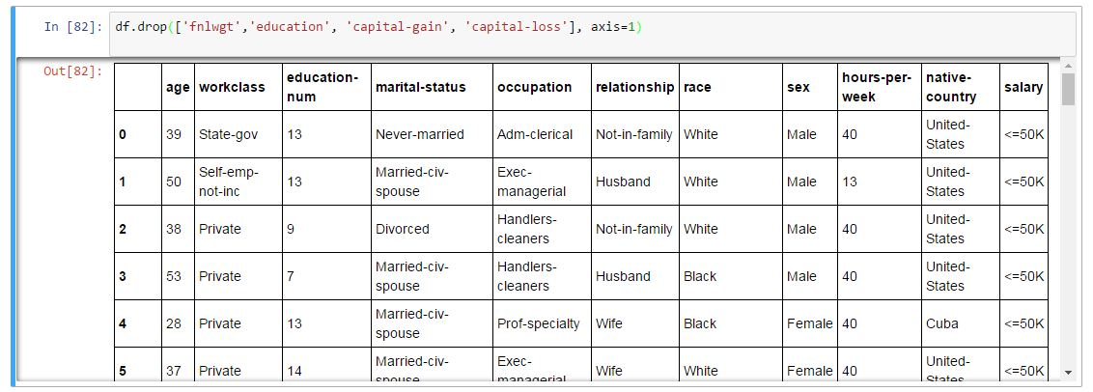
Data Pre-processing
Remove missing values
Remove duplications
Remove useless attributes

Slide 6
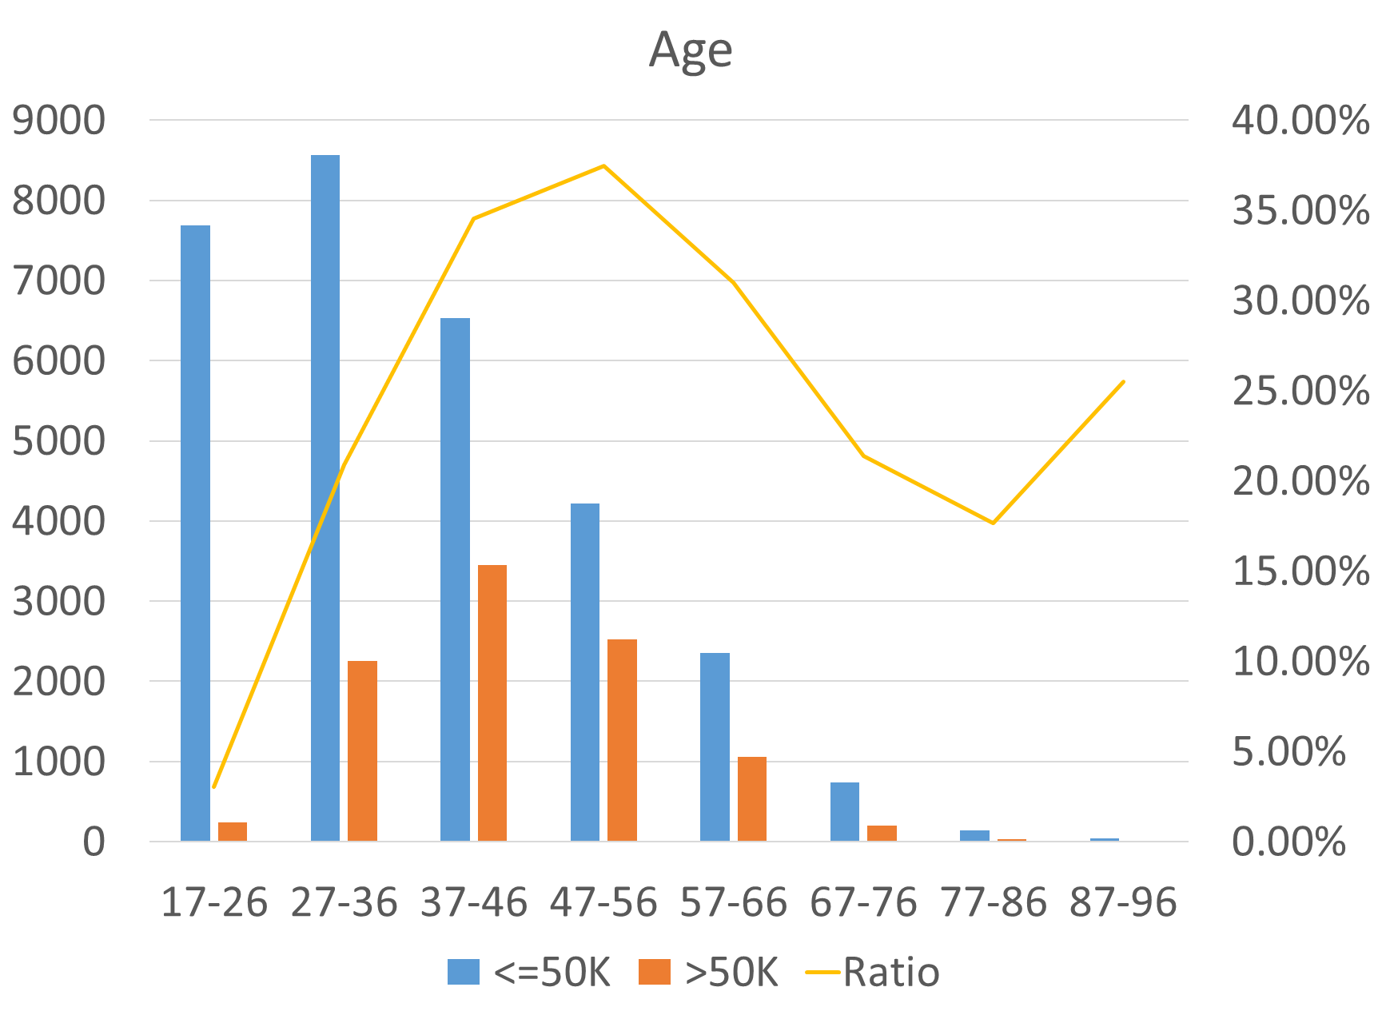
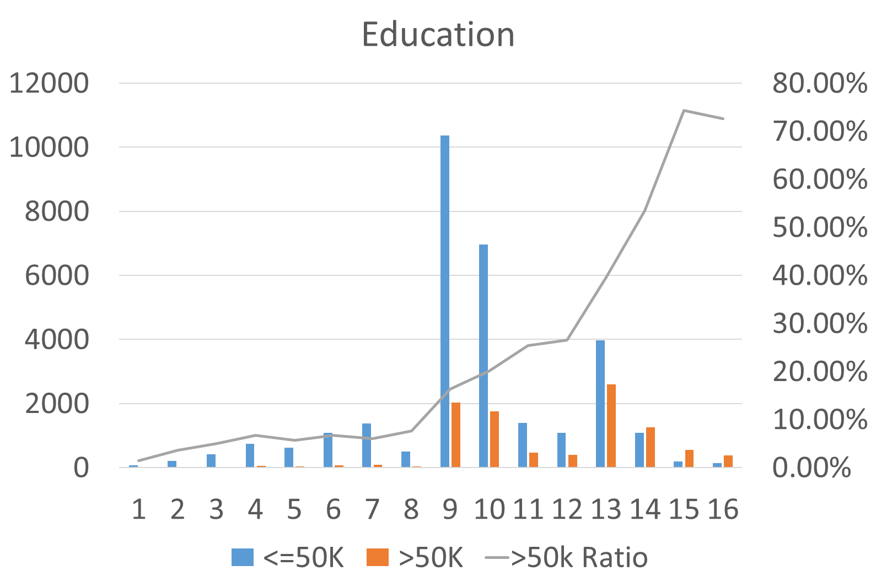
Data Analysis
The range of working ages in US is 17-90 (which is surprising)
People aged from 47-56 tends to earn the most
Most young people aged from 17-26 earn less than 50K
The higher education level, the higher possibility one people can get better paid
The possibility of earning more than 50K is increasing dramatically above level 13 (Bachelor)

Slide 7
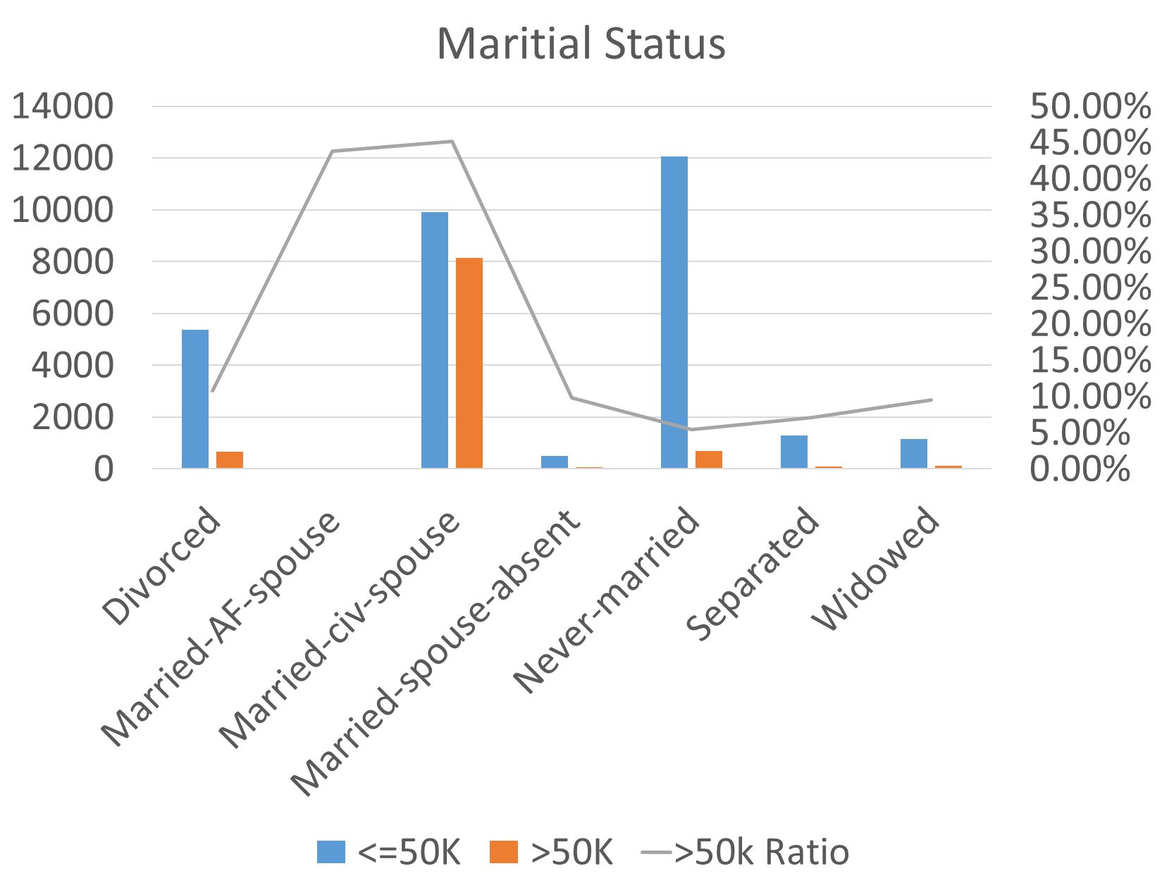
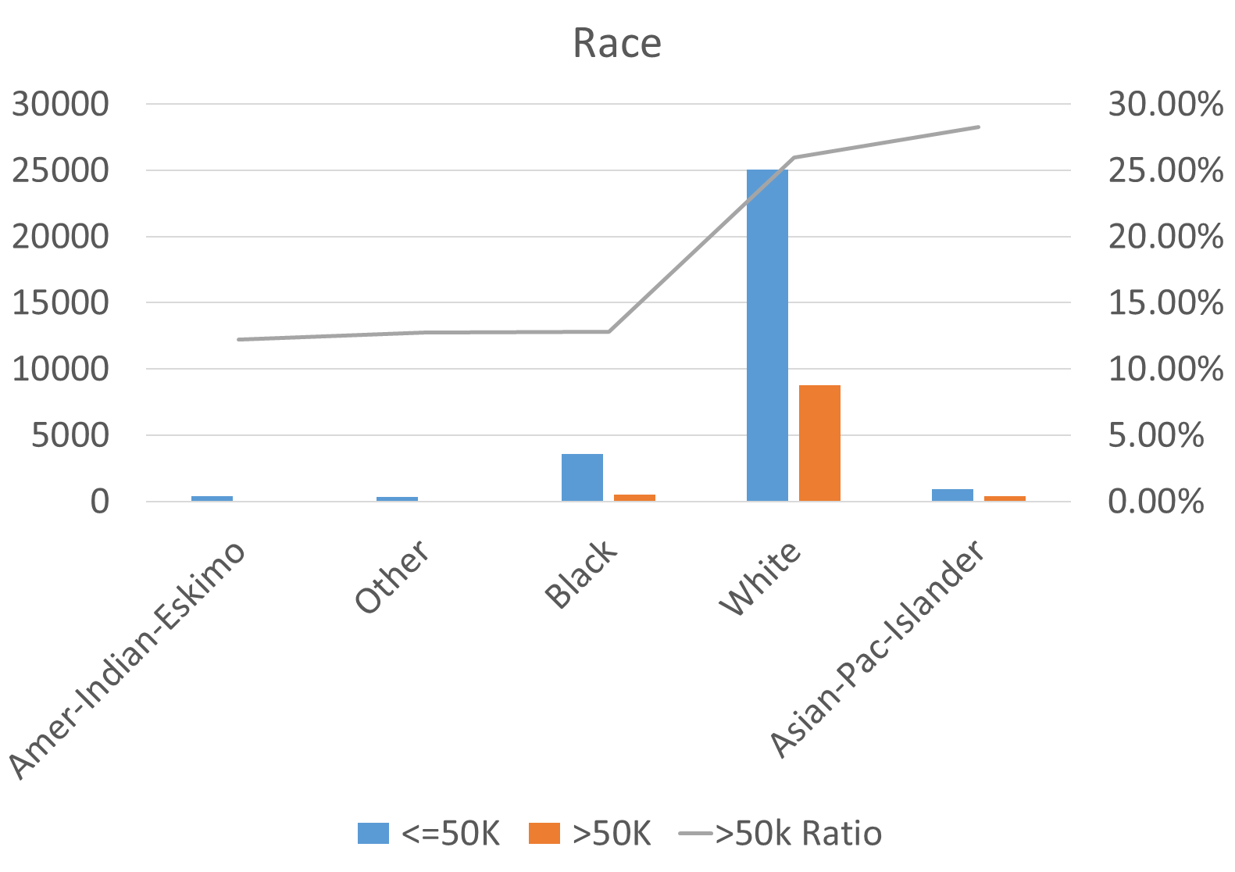
Data Analysis
Get married, then you will earn more!!!
The majority of working class is white people in US
Although minority, Asians has the highest possibility to earn more

Slide 8
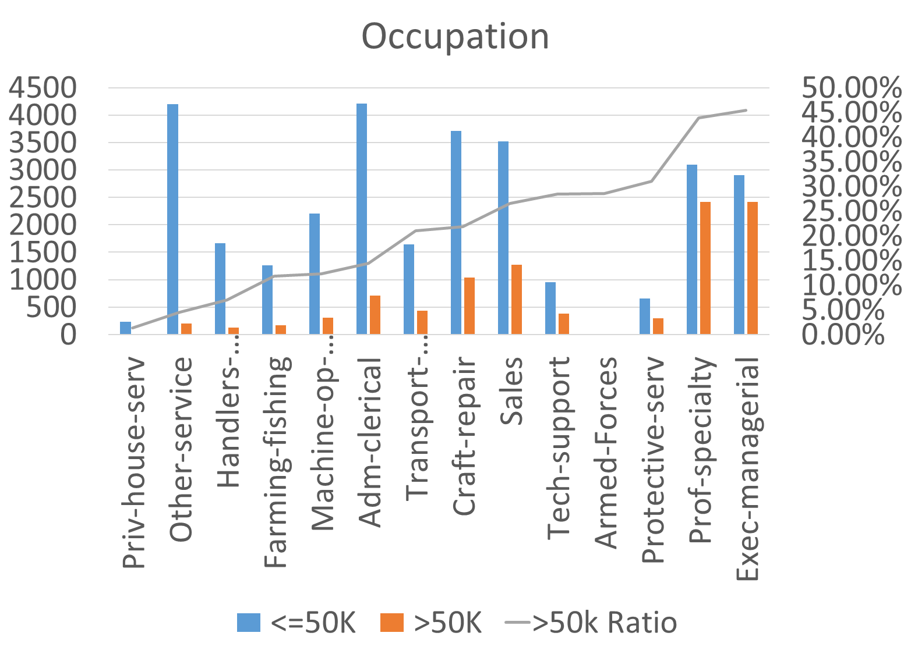
Data Analysis
The best occupation for higher salary are: prof-specialty and exec-managerial
The possibility for tech-support to earn over 50K is around 30%, moderate

Slide 9
Methodology Selection
Percentage | 50 | 55 | 60 | 65 | 70 | 75 | 80 | Average
Ibk | 76.375 | 76.3262 | 76.2324 | 75.753 | 75.5236 | 75.4864 | 75.2728 | 75.85277143
RandomForest | 79.3511 | 79.5221 | 79.532 | 79.028 | 78.9677 | 79.083 | 78.4278 | 79.13024286
Naive Bayes | 79.4668 | 79.4929 | 79.6372 | 79.3961 | 79.7827 | 79.6824 | 79.5189 | 79.56814286
RepTree | 81.0443 | 81.4804 | 81.6103 | 81.4843 | 82.1313 | 81.7962 | 82.3584 | 81.70074286
SVM | 81.5911 | 81.6732 | 81.7286 | 82.3631 | 82.587 | 82.1222 | 82.4504 | 82.07365714
J48 | 82.0959 | 81.7725 | 82.0177 | 82.2129 | 82.5695 | 82.3536 | 82.5687 | 82.22725714
SMO | 82.1432 | 82.0763 | 82.0835 | 82.318 | 82.4818 | 82.5744 | 82.4898 | 82.30957143
Logistic | 82.1327 | 82.1289 | 82.1426 | 82.273 | 82.7009 | 82.7111 | 82.6344 | 82.38908571
LMT | 82.1485 | 82.0997 | 82.1755 | 82.3856 | 82.6834 | 82.7216 | 82.9762 | 82.45578571
NBTree | 82.2694 | 82.4327 | 82.6093 | 82.3331 | 82.736 | 82.8268 | 82.9105 | 82.58825714
Average | 80.8618 | 80.90049 | 80.97691 | 80.95471 | 81.21639 | 81.13577 | 81.16079

Slide 10
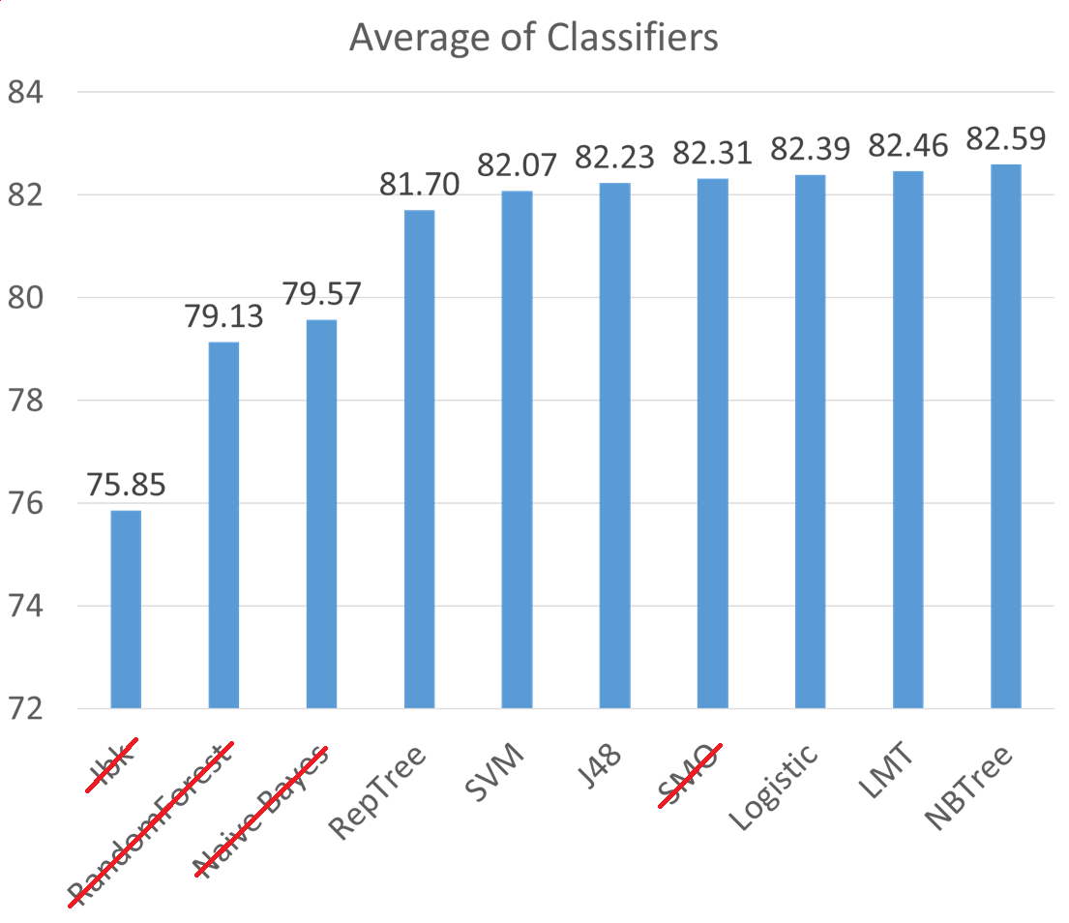
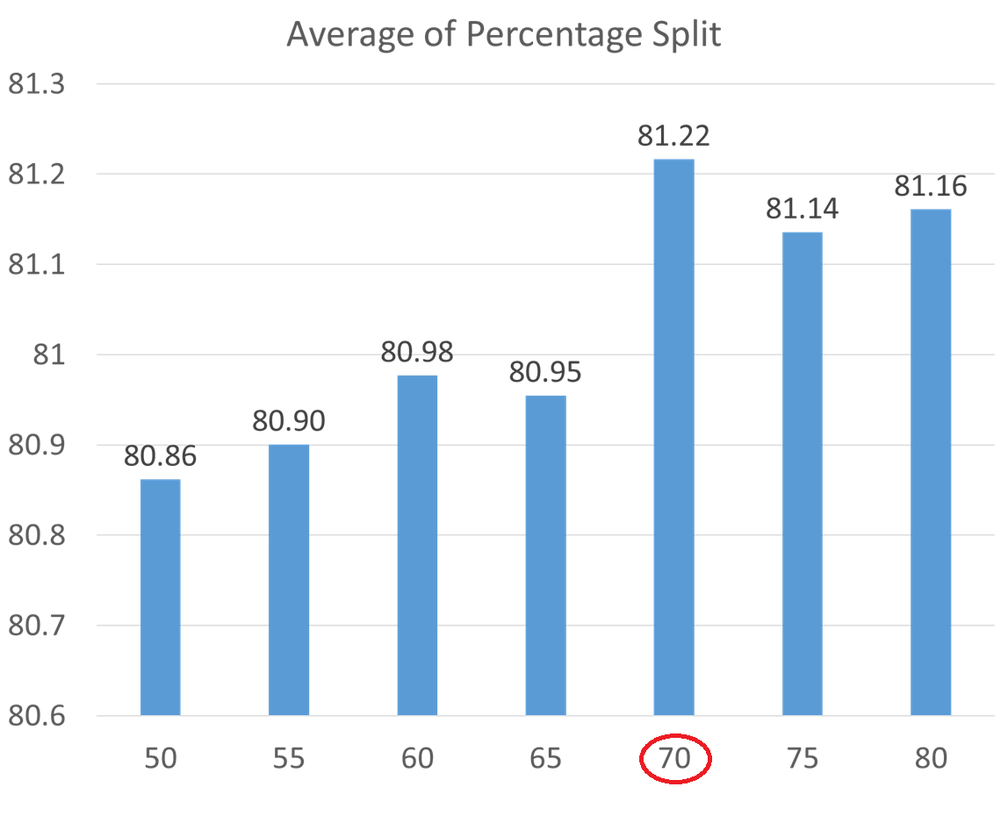
Methodology Selection – Learning Curve
Conclusion:
IBK, Random Forest and Naïve Bayes excluded because of bad performance
SMO excluded because it takes too long time to run, over 4 days running for parameter tuning, although with fair performance
The best split ratio between train and test is 70%

Slide 11
Classifier Distribution
Kritesh
Song
Vahid
REP Tree
LMT
J48
SVM
Logistic Regression
NB Tree

Slide 12
Evaluation Process
Baseline
Parameter Tuning
Further Exploration
- Stacking
- Bagging

Slide 13
Baseline Evaluation Results - Accuracy
Classifers | CV | Validate | Test
SVM | 82.40% | 82.13% | 82.74%
J48 | 82.53% | 81.67% | 82.82%
NB Tree | 82.69% | 81.92% | 83.25%
Logistic Regression | 82.70% | 81.68% | 83.15%
Logistic Model Tree (LMT) | 82.62% | 81.57% | 83.15%
REP Tree | 81.84% | 81.20% | 82.82%

Slide 14
Baseline Evaluation Results - AUC
Classifers | CV | Validate | Test
SVM | 0.710 | 0.706 | 0.712
J48 | 0.850 | 0.850 | 0.852
NB Tree | 0.870 | 0.868 | 0.873
Logistic Regression | 0.877 | 0.872 | 0.879
Logistic Model Tree (LMT) | 0.878 | 0.873 | 0.879
REP Tree | 0.843 | 0.846 | 0.853

Slide 15
Baseline Evaluation Results – F-1 Measure
Classifers | CV | Validate | Test
SVM | 0.812 | 0.809 | 0.815
J48 | 0.818 | 0.807 | 0.819
NB Tree | 0.823 | 0.814 | 0.827
Logistic Regression | 0.820 | 0.809 | 0.824
Logistic Model Tree (LMT) | 0.819 | 0.808 | 0.824
REP Tree | 0.812 | 0.806 | 0.822
Conclusion: NB Tree is the best for baseline evaluation, as it has the best accuracy and F-1 measure performance, and the AUC is very close to the best.

Slide 16
Parameter Tuning Evaluation Results
Accuracy | CV | Validate | Test
SVM | 82.78% | 82.15% | 83.20%
J48 | 82.73% | 81.95% | 83.17%
Logistic Model Tree (LMT) | 82.66% | 82.38% | 83.44%
REP Tree | 82.10% | 81.23% | 82.60%
Parameter selection methods:
Manually: J48, REP Tree
Gridsearch: SVM
Multisearch: J48, LMT
AUC | CV | Validate | Test
SVM | 0.734 | 0.724 | 0.734
J48 | 0.856 | 0.859 | 0.855
Logistic Model Tree (LMT) | 0.878 | 0.878 | 0.884
REP Tree | 0.847 | 0.846 | 0.854
F-1 measure | CV | Validate | Test
SVM | 0.821 | 0.814 | 0.824
J48 | 0.820 | 0.809 | 0.822
Logistic Model Tree (LMT) | 0.821 | 0.818 | 0.828
REP Tree | 0.814 | 0.805 | 0.819
Conclusion:
LMT is the best for all matrixes

Slide 17
Stacking Evaluation Results
Accuracy | CV | Validate | Test
NBTree & J48 & Logistic → LMT | 82.8439% | 82.4480% | 83.2862%
SVM&Naïve Bayes&J48-->Jrip | 83.9429% | 81.7152% | 83.0365%
AUC | CV | Validate | Test
NBTree & J48 & Logistic → LMT | 0.878 | 0.879 | 0.882
SVM&Naïve Bayes&J48-->Jrip | 0.767 | 0.734 | 0.749
F-1 Measure | CV | Validate | Test
NBTree & J48 & Logistic → LMT | 0.822 | 0.818 | 0.827
SVM&Naïve Bayes&J48-->Jrip | 0.836 | 0.812 | 0.825
Conclusion:
First stacking is better for all matrixes

Slide 18
Bagging Evaluation Results
Classifers | CV | Validate | Test
J48 Bagging | 82.77% | 82.05% | 83.29%
NB Tree Bagging | 82.88% | 82.43% | 83.60%
Classifers | CV | Validate | Test
J48 Bagging | 0.866 | 0.869 | 0.864
NB Tree Bagging | 0.875 | 0.879 | 0.880
Classifers | CV | Validate | Test
J48 Bagging | 0.821 | 0.812 | 0.824
NB Tree Bagging | 0.823 | 0.818 | 0.830
Conclusion:
NB Tree bagging is better for all matrixes

Slide 19
Conclusion
Accuracy | CV | Validate | Test
Baseline | 82.69% | 81.92% | 83.25%
Parameter Tuning | 82.66% | 82.38% | 83.44%
Stacking | 82.84% | 82.45% | 83.29%
Bagging | 82.88% | 82.43% | 83.60%
Conclusion:
No significant difference found after t-test
NB Tree bagging is the best method with the best performance of Accuracy and F-1 measure, and slightly worse performance on AUC
AUC | CV | Validate | Test
Baseline | 0.870 | 0.868 | 0.873
Parameter Tuning | 0.878 | 0.878 | 0.884
Stacking | 0.878 | 0.879 | 0.882
Bagging | 0.875 | 0.879 | 0.880
F-1 Measure | CV | Validate | Test
Baseline | 0.823 | 0.814 | 0.827
Parameter Tuning | 0.821 | 0.818 | 0.828
Stacking | 0.822 | 0.818 | 0.827
Bagging | 0.823 | 0.818 | 0.830

Slide 20
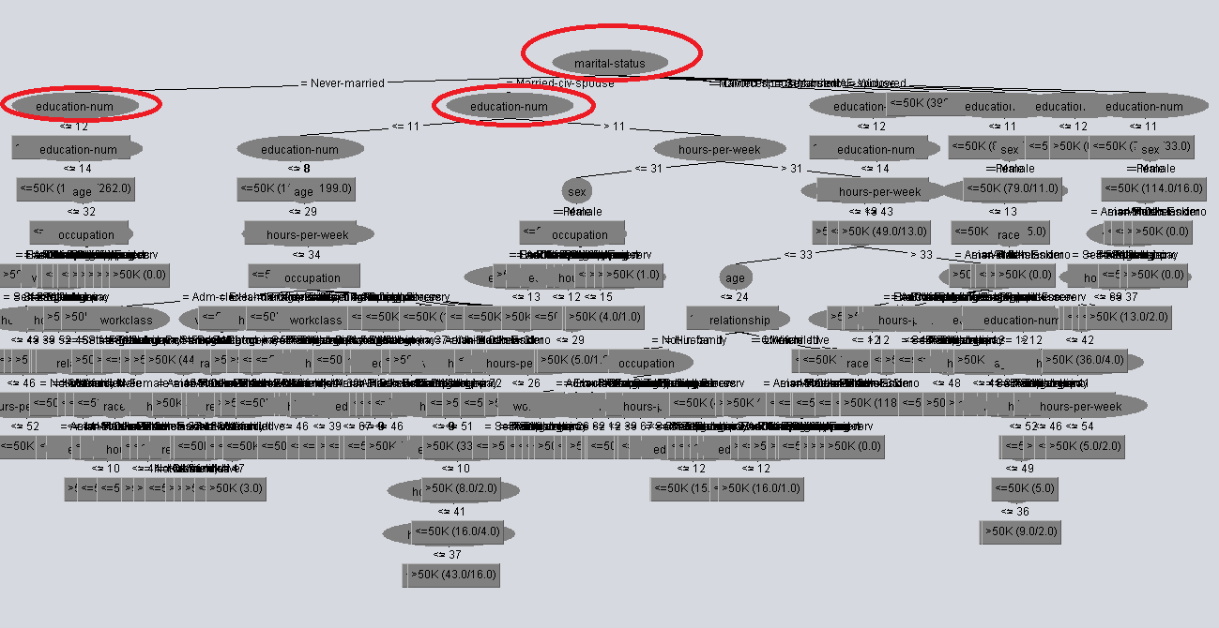
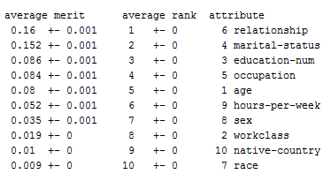
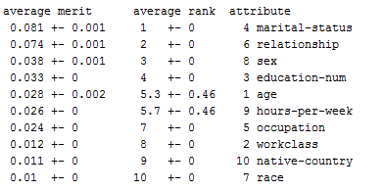
J48 Tree
Infogain ranking
Gainratio ranking

Slide 21
THANK YOU

